Slide 1
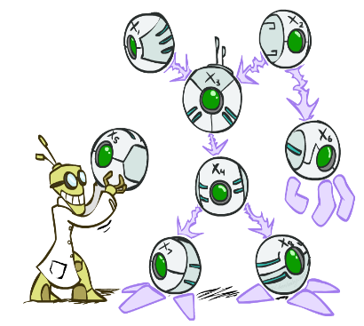
Artificial Intelligence
Bayes’ Nets
Instructors: David Suter and Qince Li
Course Delivered @ Harbin Institute of Technology
[Many slides adapted from those created by Dan Klein and Pieter Abbeel for CS188 Intro to AI at UC Berkeley. Some others from colleagues at Adelaide University.]
Notes:
Please retain proper attribution, including the reference to ai.berkeley.edu. Thanks!

Slide 2

Probabilistic Models
Models describe how (a portion of) the world works
Models are always simplifications
May not account for every variable
May not account for all interactions between variables
“All models are wrong; but some are useful.” – George E. P. Box
What do we do with probabilistic models?
We (or our agents) need to reason about unknown variables, given evidence
Example: explanation (diagnostic reasoning)
Example: prediction (causal reasoning)
Example: value of information
Notes:
George Box: All models are wrong; some of them are useful

Slide 3

Independence

Slide 4


Independence
Two variables are independent if:
This says that their joint distribution factors into a product two simpler distributions
Another form:
We write:
Independence is a simplifying modeling assumption
Empirical joint distributions: at best “close” to independent
What could we assume for {Weather, Traffic, Cavity, Toothache}?

Slide 5
Example: Independence?
T | P
hot | 0.5
cold | 0.5
T | W | P
hot | sun | 0.4
hot | rain | 0.1
cold | sun | 0.2
cold | rain | 0.3
T | W | P
hot | sun | 0.3
hot | rain | 0.2
cold | sun | 0.3
cold | rain | 0.2
W | P
sun | 0.6
rain | 0.4
Notes:
Would need to check P1 or P2 for P(TW)=P(T)P(W) clearly P2 is but P1 isn’t

Slide 6


Example: Independence
N fair, independent coin flips:
H | 0.5
T | 0.5
H | 0.5
T | 0.5
H | 0.5
T | 0.5

Slide 7

Conditional Independence
P(Toothache, Cavity, Catch)
If I have a cavity, the probability that the probe catches in it doesn't depend on whether I have a toothache:
P(+catch | +toothache, +cavity) = P(+catch | +cavity)
The same independence holds if I don’t have a cavity:
P(+catch | +toothache, -cavity) = P(+catch| -cavity)
Catch is conditionally independent of Toothache given Cavity:
P(Catch | Toothache, Cavity) = P(Catch | Cavity)
Equivalent statements:
P(Toothache | Catch , Cavity) = P(Toothache | Cavity)
P(Toothache, Catch | Cavity) = P(Toothache | Cavity) P(Catch | Cavity)
One can be derived from the other easily

Slide 8

Conditional Independence
Unconditional (absolute) independence very rare
Conditional independence is our most basic and robust form of knowledge about uncertain environments.
X is conditionally independent of Y given Z
if and only if:
or, equivalently, if and only if

Slide 9
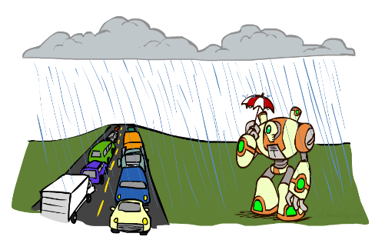
Conditional Independence
What about this domain:
Traffic
Umbrella
Raining

Slide 10
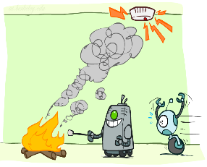
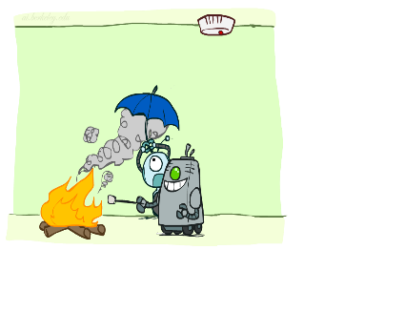
Conditional Independence
What about this domain:
Fire
Smoke
Alarm

Slide 11

Conditional Independence and the Chain Rule
Chain rule:
Trivial decomposition:
With assumption of conditional independence:
Bayes’nets / graphical models help us express conditional independence assumptions

Slide 12

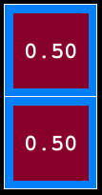
Ghostbusters Chain Rule
Each sensor depends only on where the ghost is
That means, the two sensors are conditionally independent, given the ghost position
T: Top square is red B: Bottom square is red G: Ghost is in the top
Givens:
P( +g ) = 0.5
P( -g ) = 0.5
P( +t | +g ) = 0.8 P( +t | -g ) = 0.4 P( +b | +g ) = 0.4 P( +b | -g ) = 0.8
P(T,B,G) = P(G) P(T|G) P(B|G)
T | B | G | P(T,B,G)
+t | +b | +g | 0.16
+t | +b | -g | 0.16
+t | -b | +g | 0.24
+t | -b | -g | 0.04
-t | +b | +g | 0.04
-t | +b | -g | 0.24
-t | -b | +g | 0.06
-t | -b | -g | 0.06

Slide 13
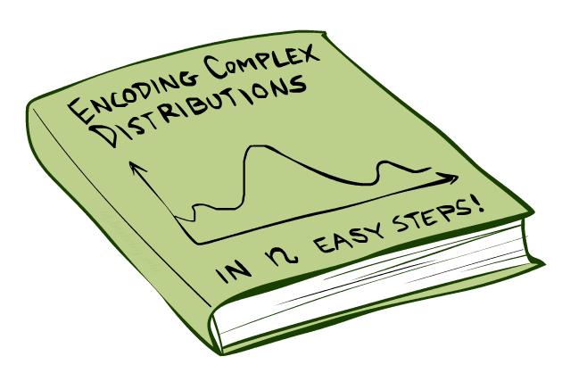
Bayes’Nets: Big Picture

Slide 14

Bayes’ Nets: Big Picture
Two problems with using full joint distribution tables as our probabilistic models:
Unless there are only a few variables, the joint is WAY too big to represent explicitly
Hard to learn (estimate) anything empirically about more than a few variables at a time
Bayes’ nets: a technique for describing complex joint distributions (models) using simple, local distributions (conditional probabilities)
More properly called graphical models
We describe how variables locally interact
Local interactions chain together to give global, indirect interactions
For about 10 min, we’ll be vague about how these interactions are specified

Slide 15
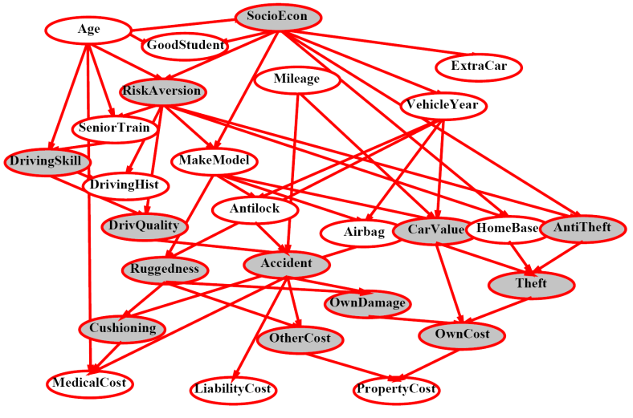
Example Bayes’ Net: Insurance

Slide 16
Example Bayes’ Net: Car

Slide 17
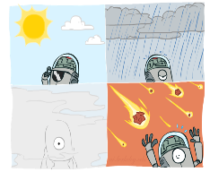
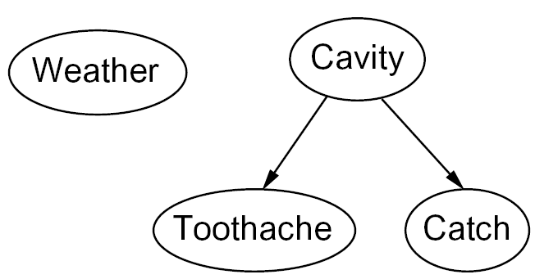

Graphical Model Notation
Nodes: variables (with domains)
Can be assigned (observed) or unassigned (unobserved)
Arcs: interactions
Indicate “direct influence” between variables
Formally: encode conditional independence (more later)

Slide 18

Example: Coin Flips
N independent coin flips
No interactions between variables: absolute independence
X₁
X₂
X_{n}

Slide 19
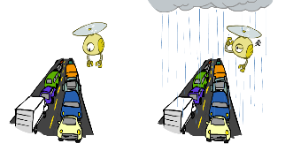
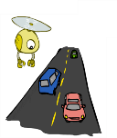
Example: Traffic
Variables:
R: It rains
T: There is traffic
Model 1: independence
Why is an agent using model 2 better?
Model 2: rain causes traffic
R
R
T
T

Slide 20
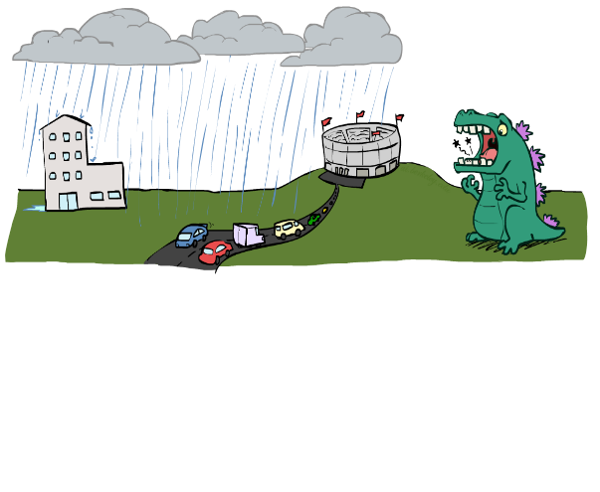
Example: Traffic II
Let’s build a causal graphical model!
Variables
T: Traffic
R: It rains
L: Low pressure
D: Roof drips
B: Ballgame
C: Cavity

Slide 21
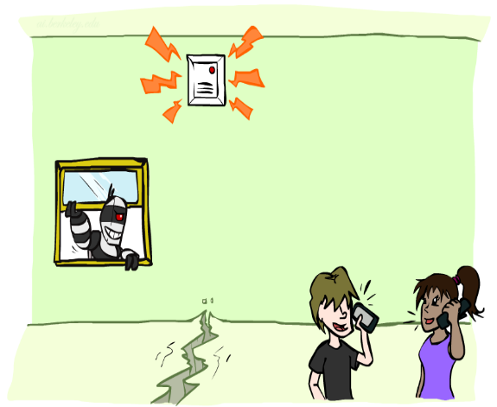
Example: Alarm Network
Variables
B: Burglary
A: Alarm goes off
M: Mary calls
J: John calls
E: Earthquake!

Slide 22
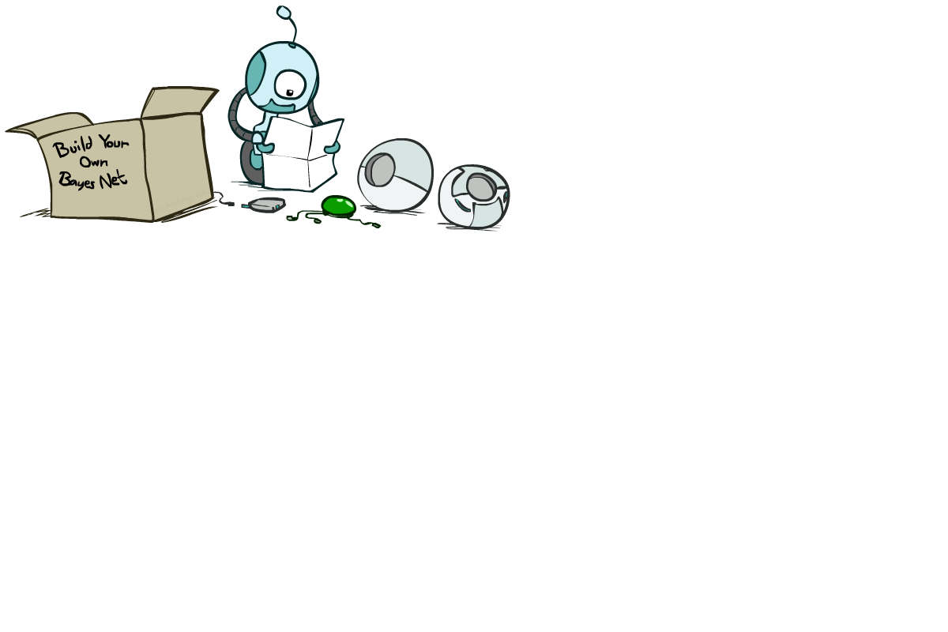
Bayes’ Net Semantics

Slide 23
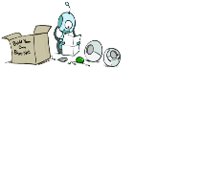


Bayes’ Net Semantics
A set of nodes, one per variable X
A directed, acyclic graph
A conditional distribution for each node
A collection of distributions over X, one for each combination of parents’ values
CPT: conditional probability table
Description of a noisy “causal” process
A₁
A_{n}
X
A Bayes net = Topology (graph) + Local Conditional Probabilities

Slide 24


Probabilities in BNs
Bayes’ nets implicitly encode joint distributions
As a product of local conditional distributions
To see what probability a BN gives to a full assignment, multiply all the relevant conditionals together:
Example:

Slide 25
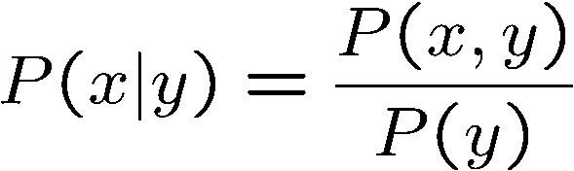

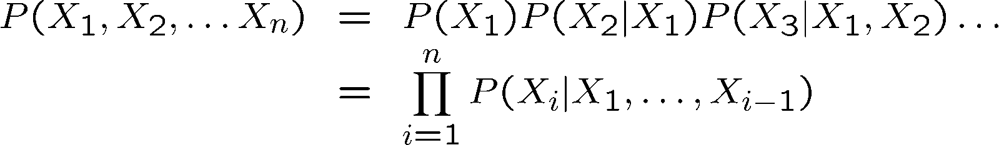

Probability Recap
Conditional probability
Product rule
Chain rule
X, Y independent if and only if:
X and Y are conditionally independent given Z if and only if:

Slide 26

Bayes’ Nets
A Bayes’ net is an
efficient encoding
of a probabilistic
model of a domain
Questions we can ask:
Inference: given a fixed BN, what is P(X | e)?
Representation: given a BN graph, what kinds of distributions can it encode?
Modeling: what BN is most appropriate for a given domain?

Slide 27


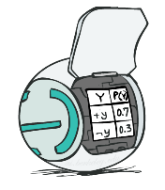
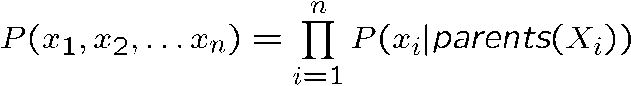
Bayes’ Net Semantics
A directed, acyclic graph, one node per random variable
A conditional probability table (CPT) for each node
A collection of distributions over X, one for each combination of parents’ values
Bayes’ nets implicitly encode joint distributions
As a product of local conditional distributions
To see what probability a BN gives to a full assignment, multiply all the relevant conditionals together:

Slide 28


Probabilities in BNs
Why are we guaranteed that setting
results in a proper joint distribution?
Chain rule (valid for all distributions):
Assume conditional independences:
→ Consequence:

Slide 29

Example: Coin Flips
X₁
X₂
X_{n}
h | 0.5
t | 0.5
h | 0.5
t | 0.5
h | 0.5
t | 0.5
Only distributions whose variables are absolutely independent can be represented by a Bayes’ net with no arcs.
Notes:
demo

Slide 30
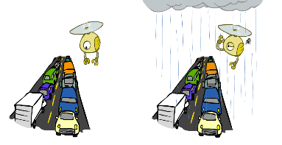
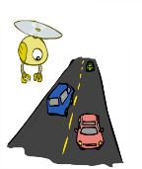

Example: Traffic
Causal direction
R
+r | 1/4
-r | 3/4
+r | +t | 3/4
 | -t | 1/4
T
-r | +t | 1/2
 | -t | 1/2

Slide 31
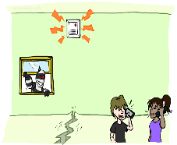
Example: Alarm Network
B | P(B)
+b | 0.001
-b | 0.999
E | P(E)
+e | 0.002
-e | 0.998
Burglary
Earthqk
Alarm
B | E | A | P(A|B,E)
+b | +e | +a | 0.95
+b | +e | -a | 0.05
+b | -e | +a | 0.94
+b | -e | -a | 0.06
-b | +e | +a | 0.29
-b | +e | -a | 0.71
-b | -e | +a | 0.001
-b | -e | -a | 0.999
John calls
Mary calls
A | J | P(J|A)
+a | +j | 0.9
+a | -j | 0.1
-a | +j | 0.05
-a | -j | 0.95
A | M | P(M|A)
+a | +m | 0.7
+a | -m | 0.3
-a | +m | 0.01
-a | -m | 0.99
Notes:
demo

Slide 32
Example: Traffic
Causal direction
R
+r | 1/4
-r | 3/4
+r | +t | 3/16
+r | -t | 1/16
-r | +t | 6/16
-r | -t | 6/16
+r | +t | 3/4
 | -t | 1/4
T
-r | +t | 1/2
 | -t | 1/2

Slide 33
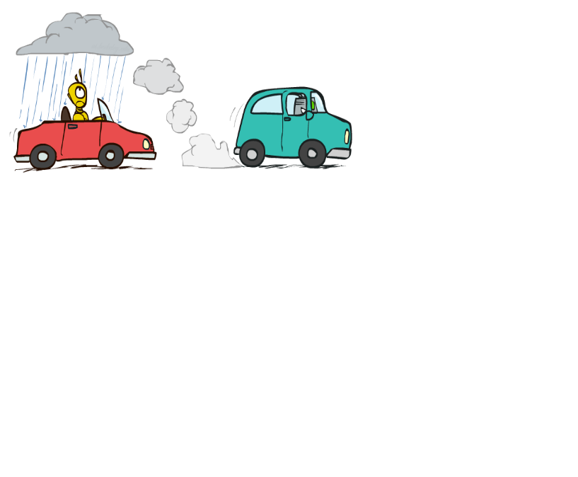

Example: Reverse Traffic
Reverse causality?
T
+t | 9/16
-t | 7/16
+r | +t | 3/16
+r | -t | 1/16
-r | +t | 6/16
-r | -t | 6/16
+t | +r | 1/3
 | -r | 2/3
R
-t | +r | 1/7
 | -r | 6/7

Slide 34
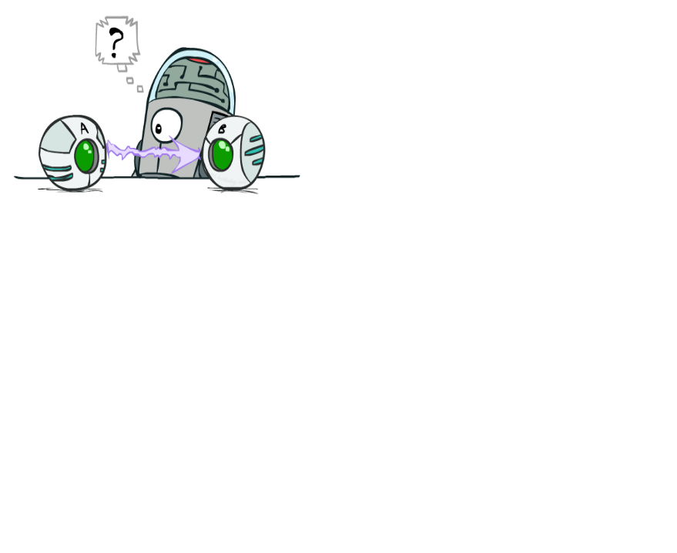
Causality?
When Bayes’ nets reflect the true causal patterns:
Often simpler (nodes have fewer parents)
Often easier to think about
Often easier to elicit from experts
BNs need not actually be causal
Sometimes no causal net exists over the domain (especially if variables are missing)
End up with arrows that reflect correlation, not causation
What do the arrows really mean?
Topology may happen to encode causal structure
Topology really encodes conditional independence

Slide 35

Bayes’ Nets
So far: how a Bayes’ net encodes a joint distribution
Next: how to answer queries about that distribution
Today:
First assembled BNs using an intuitive notion of conditional independence as causality
Then saw that key property is conditional independence
Main goal: answer queries about conditional independence and influence
After that: how to answer numerical queries (inference)

Slide 36
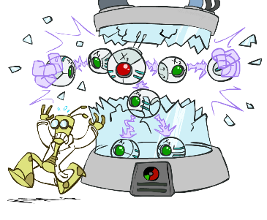
Artificial Intelligence
Bayes’ Nets: Independence
Instructors: David Suter and Qince Li
Course Delivered @ Harbin Institute of Technology
[Many slides adapted from those created by Dan Klein and Pieter Abbeel for CS188 Intro to AI at UC Berkeley. Some others from colleagues at Adelaide University.]
Notes:
Please retain proper attribution, including the reference to ai.berkeley.edu. Thanks!

Slide 37
Probability Recap
Conditional probability
Product rule
Chain rule
X, Y independent if and only if:
X and Y are conditionally independent given Z if and only if:

Slide 38
Bayes’ Nets
A Bayes’ net is an
efficient encoding
of a probabilistic
model of a domain
Questions we can ask:
Inference: given a fixed BN, what is P(X | e)?
Representation: given a BN graph, what kinds of distributions can it encode?
Modeling: what BN is most appropriate for a given domain?

Slide 39
Bayes’ Net Semantics
A directed, acyclic graph, one node per random variable
A conditional probability table (CPT) for each node
A collection of distributions over X, one for each combination of parents’ values
Bayes’ nets implicitly encode joint distributions
As a product of local conditional distributions
To see what probability a BN gives to a full assignment, multiply all the relevant conditionals together:

Slide 40


Example: Alarm Network
B | P(B)
+b | 0.001
-b | 0.999
B
E
E | P(E)
+e | 0.002
-e | 0.998
A
A | J | P(J|A)
+a | +j | 0.9
+a | -j | 0.1
-a | +j | 0.05
-a | -j | 0.95
A | M | P(M|A)
+a | +m | 0.7
+a | -m | 0.3
-a | +m | 0.01
-a | -m | 0.99
B | E | A | P(A|B,E)
+b | +e | +a | 0.95
+b | +e | -a | 0.05
+b | -e | +a | 0.94
+b | -e | -a | 0.06
-b | +e | +a | 0.29
-b | +e | -a | 0.71
-b | -e | +a | 0.001
-b | -e | -a | 0.999
J
M
Notes:
demo

Slide 41

Example: Alarm Network
B | P(B)
+b | 0.001
-b | 0.999
B
E
E | P(E)
+e | 0.002
-e | 0.998
A
A | J | P(J|A)
+a | +j | 0.9
+a | -j | 0.1
-a | +j | 0.05
-a | -j | 0.95
A | M | P(M|A)
+a | +m | 0.7
+a | -m | 0.3
-a | +m | 0.01
-a | -m | 0.99
B | E | A | P(A|B,E)
+b | +e | +a | 0.95
+b | +e | -a | 0.05
+b | -e | +a | 0.94
+b | -e | -a | 0.06
-b | +e | +a | 0.29
-b | +e | -a | 0.71
-b | -e | +a | 0.001
-b | -e | -a | 0.999
J
M
Notes:
demo

Slide 42

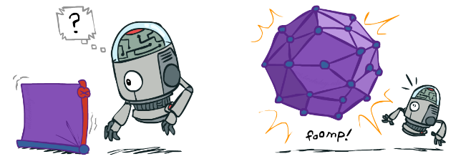
Size of a Bayes’ Net
How big is a joint distribution over N Boolean variables?
2^{N}
How big is an N-node net if nodes have up to k parents?
O(N * 2^{k+1})
Both give you the power to calculate
BNs: Huge space savings!
Also easier to elicit local CPTs
Also faster to answer queries (coming)

Slide 43

Bayes’ Nets
Representation
Conditional Independences
Probabilistic Inference
Learning Bayes’ Nets from Data

Slide 44

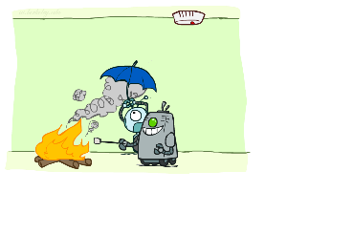

Conditional Independence
X and Y are independent if
X and Y are conditionally independent given Z
(Conditional) independence is a property of a distribution
Example:

Slide 45
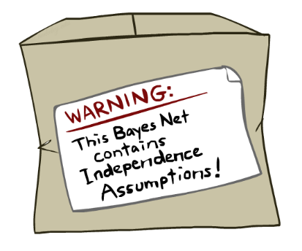
Bayes Nets: Assumptions
Assumptions we are required to make to define the Bayes net when given the graph:
Beyond above “chain rule → Bayes net” conditional independence assumptions
Often additional conditional independences
They can be read off the graph
Important for modeling: understand assumptions made when choosing a Bayes net graph
Notes:
Important for modeling: understanding which assumptions you are making!

Slide 46
Example
X
Y
Z
W
Conditional independence assumptions directly from simplifications in chain rule:
Additional implied conditional independence assumptions?

Slide 47
Independence in a BN
Important question about a BN:
Are two nodes independent given certain evidence?
If yes, can prove using algebra (tedious in general)
If no, can prove with a counter example
Example:
Question: are X and Z necessarily independent?
Answer: no. Example: low pressure causes rain, which causes traffic.
X can influence Z, Z can influence X (via Y)
Addendum: they could be independent: how?
X
Y
Z

Slide 48
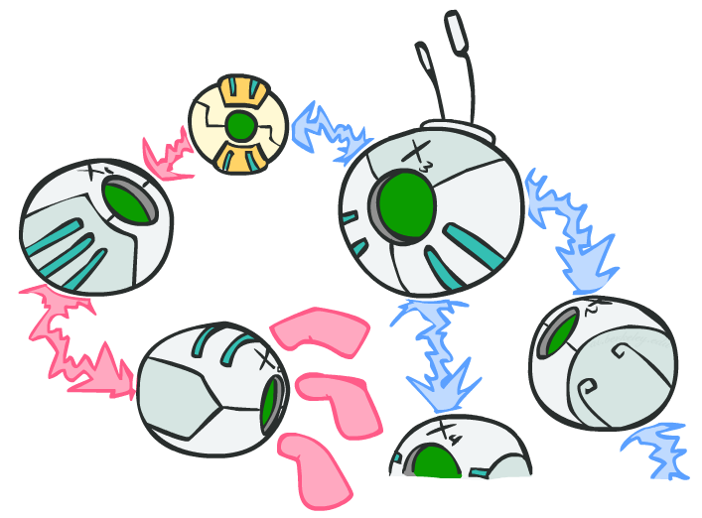
D-separation: Outline

Slide 49
D-separation: Outline
Study independence properties for triples
Analyze complex cases in terms of member triples
D-separation: a condition / algorithm for answering such queries

Slide 50
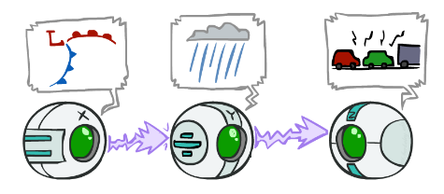
Causal Chains
This configuration is a “causal chain”
Guaranteed X independent of Z ? No!
One example set of CPTs for which X is not independent of Z is sufficient to show this independence is not guaranteed.
Example:
Low pressure causes rain causes traffic,
high pressure causes no rain causes no
traffic
In numbers:
P( +y | +x ) = 1, P( -y | - x ) = 1,
P( +z | +y ) = 1, P( -z | -y ) = 1
X: Low pressure Y: Rain Z: Traffic

Slide 51
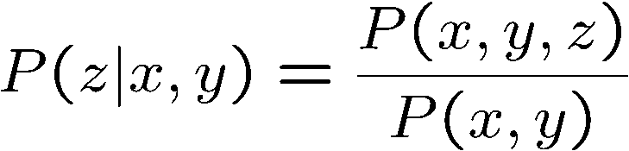
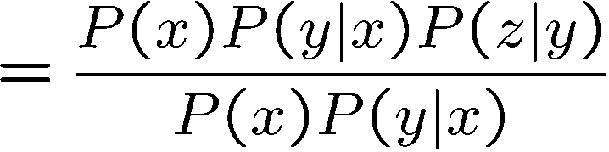

Causal Chains
This configuration is a “causal chain”
Guaranteed X independent of Z given Y?
Evidence along the chain “blocks” the influence
X: Low pressure Y: Rain Z: Traffic
Yes!

Slide 52
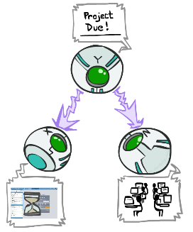
Common Cause
This configuration is a “common cause”
Guaranteed X independent of Z ? No!
One example set of CPTs for which X is not independent of Z is sufficient to show this independence is not guaranteed.
Example:
Project due causes both forums busy
and lab full
In numbers:
P( +x | +y ) = 1, P( -x | -y ) = 1,
P( +z | +y ) = 1, P( -z | -y ) = 1
Y: Project due
X: Forums busy
Z: Lab full

Slide 53
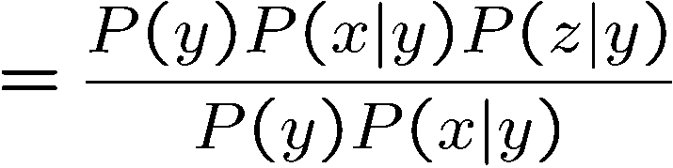
Common Cause
This configuration is a “common cause”
Guaranteed X and Z independent given Y?
Observing the cause blocks influence between effects.
Y: Project due
X: Forums busy
Z: Lab full
Yes!

Slide 54
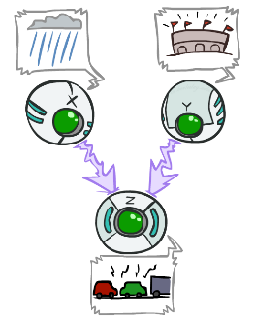
Common Effect
Last configuration: two causes of one effect (v-structures)
Are X and Y independent?
Yes: the ballgame and the rain cause traffic, but they are not correlated
Still need to prove they must be (try it!)
Are X and Y independent given Z?
No: seeing traffic puts the rain and the ballgame in competition as explanation.
This is backwards from the other cases
Observing an effect activates influence between possible causes.
X: Raining
Y: Ballgame
Z: Traffic

Slide 55
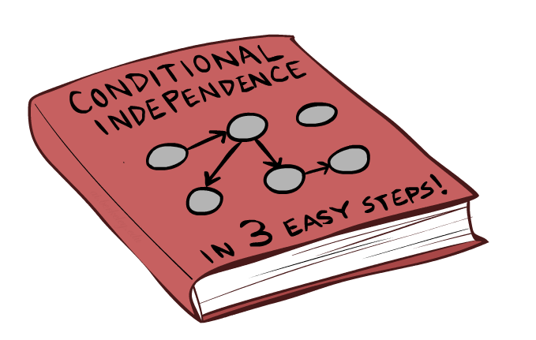
The General Case

Slide 56
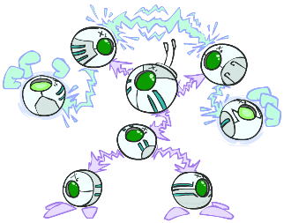
The General Case
General question: in a given BN, are two variables independent (given evidence)?
Solution: analyze the graph
Any complex example can be broken
into repetitions of the three canonical cases

Slide 57


Reachability
L
Recipe: shade evidence nodes, look for paths in the resulting graph
Attempt 1: if two nodes are connected by an undirected path blocked by a shaded node, they are conditionally independent
Almost works, but not quite
Where does it break?
Answer: the v-structure at T doesn’t count as a link in a path unless “active”
R
B
D
T

Slide 58
Active / Inactive Paths
Question: Are X and Y conditionally independent given evidence variables {Z}?
Yes, if X and Y “d-separated” by Z
Consider all (undirected) paths from X to Y
No active paths = independence!
A path is active if each triple is active:
Causal chain A → B → C where B is unobserved (either direction)
Common cause A ← B → C where B is unobserved
Common effect (aka v-structure)
A → B ← C where B or one of its descendents is observed
All it takes to block a path is a single inactive segment
Active Triples
Inactive Triples

Slide 59



D-Separation
?
Query:
Check all (undirected!) paths between and
If one or more active, then independence not guaranteed
Otherwise (i.e. if all paths are inactive),
then independence is guaranteed

Slide 60


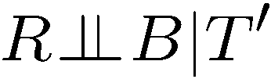
Example
Yes
R
B
T
T’
Notes:
T’: traffic report

Slide 61
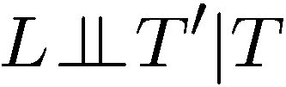


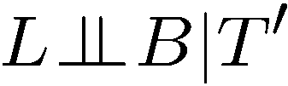

Example
L
Yes
R
B
Yes
D
T
Yes
T’

Slide 62



Example
Variables:
R: Raining
T: Traffic
D: Roof drips
S: I’m sad
Questions:
R
T
D
S
Yes

Slide 63

Structure Implications
Given a Bayes net structure, can run d-separation algorithm to build a complete list of conditional independences that are necessarily true of the form
This list determines the set of probability distributions that can be represented

Slide 64
Topology Limits Distributions
Given some graph topology G, only certain joint distributions can be encoded
The graph structure guarantees certain (conditional) independences
(There might be more independence)
Adding arcs increases the set of distributions, but has several costs
Full conditioning can encode any distribution
Y
Y
X
Z
X
Z
Y
X
Z
Y
X
Z
Y
Y
Y
X
Z
X
Z
X
Z
Y
Y
Y
X
Z
X
Z
X
Z

Slide 65
Bayes Nets Representation Summary
Bayes nets compactly encode joint distributions
Guaranteed independencies of distributions can be deduced from BN graph structure
D-separation gives precise conditional independence guarantees from graph alone
A Bayes’ net’s joint distribution may have further (conditional) independence that is not detectable until you inspect its specific distribution

Slide 66
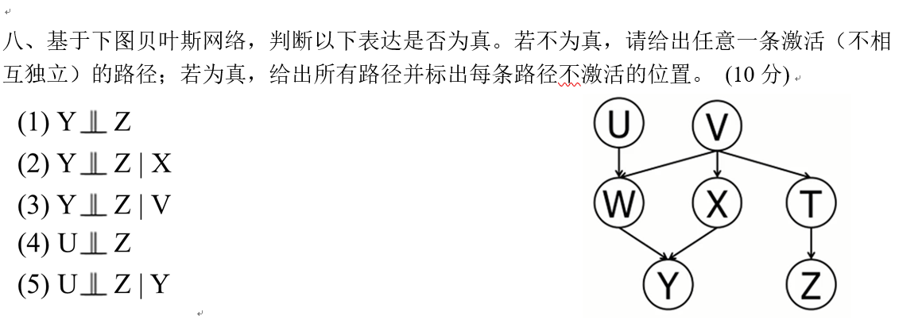
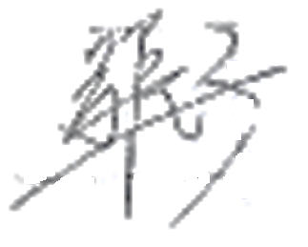
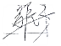
Example
(1)
U
V
(2)
U
V
|
Y
(3)
W
T
(4)
W
T
|
V
(5)
W
T
|
Y, V

Slide 67
Bayes’ Nets
Representation
Conditional Independences
Probabilistic Inference
Enumeration (exact, exponential complexity)
Variable elimination (exact, worst-case
exponential complexity, often better)
Probabilistic inference is NP-complete
Sampling (approximate)
Learning Bayes’ Nets from Data

